Slide 1
Interrupt Management
in Linux

Slide 2
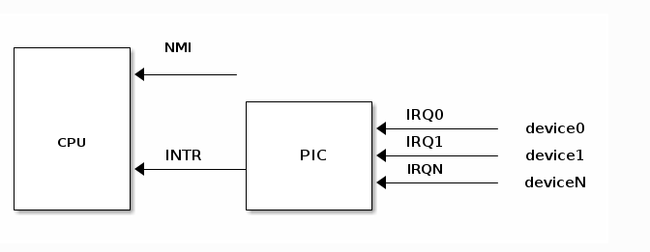
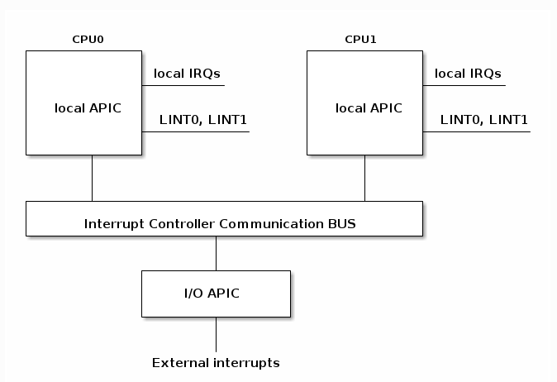
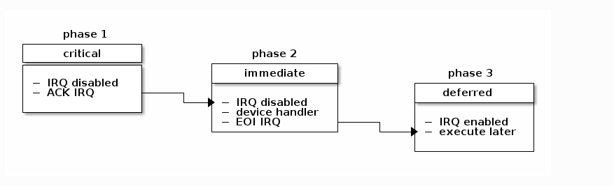
Interrupts can be grouped into two categories based on the source of the interrupt
-> synchronous, generated by executing an instruction
-> asynchronous, generated by an external event
maskable
-> can be ignored
-> signaled via INT pin
-> non-maskable
->cannot be ignored
->signaled via NMI pin
Processor detected exceptions are raised when an abnormal condition is detected while executing an instruction. A fault is a type of exception that is reported before the execution of the instruction and can be usually corrected. The saved EIP is the address of the instruction that caused the fault, so after the fault is corrected the program can re-execute the faulty instruction. (e.g page fault).
A trap is a type of exception that is reported after the execution of the instruction in which the exception was detected. The saved EIP is the address of the instruction after the instruction that caused the trap. (e.g debug trap).

Slide 3
Interrupt context
While an interrupt is handled (from the time the CPU jumps to the interrupt handler until the interrupt handler returns - e.g. IRET is issued) it is said that code runs in "interrupt context".
Code that runs in interrupt context has the following properties:
- it runs as a result of an IRQ (not of an exception)
- there is no well defined process context associated
- not allowed to trigger a context switch (no sleep, schedule, or user memory access)
request_irq()
devm_request_irq()
request_threaded_irq()
devm_request_threaded_irq() (recommended!)

Slide 4
1. The peripheral device (the NIC) now needs to emit (assert) a hardware interrupt; thus, it asserts its line on the PIC (low or high logic as required; all this is internal to the hardware).
2. The PIC, on seeing that a peripheral line has been asserted, saves the asserted line
value in a register.
3. The PIC then asserts the CPU's interrupt pin.
4. The control unit on the processor checks for the presence of hardware interrupts on every CPU after every single machine instruction runs. Thus, if a hardware
interrupt occurs, it will certainly come to know about it almost immediately. The
CPU will then raise a hardware interrupt
5.The low-level (BSP/platform) code on the OS will be hooked into this and will
react (this is often code that's at the assembly level); for example, on the ARM-32,
the low-level C entry point for a hardware interrupt is
arch/arm/kernel/irq.c:asm_do_IRQ() .
6. From here, the OS executes code paths that ultimately invoke the registered
interrupt handler routine(s) of the driver(s) this interrupt is to be serviced by.
The Linux kernel provides an abstraction layer to abstract away all the hardware-level
differences; it's referred to as the generic interrupt (or IRQ) handling layer. Essentially, it performs the required work under the hood and exposes APIs and data structures that are completely generic. Thus, at least theoretically, your code will work on any platform.

Slide 5
Installing Interrupt Handler:
#include <asm/io.h>
int request_irq(unsigned int irq, irqreturn_t (*handler)(int, void *), unsigned long irqflags, const char *devname, void *dev_id);
The first parameter, irq, specifies the interrupt number or line to allocate. For some devices this interrupt number is fixed (for example in PC system timer’s irq is 0 and keyboard’s irq is 1) where as for other devices such as PCI, irq need to be found dynamically.
The second parameter, handler is a pointer to the actual interrupt handler that services this interrupt. The third parameter, irqflags, may be either zero or bit mask of one or more of the following flags:
• IRQF_SHARED: This flags specifies that the interrupt line can be shared among multiple interrupt handlers. Each handler registered on a given line must specify this flag .
IRQF_ONESHOT : The IRQ is not enabled after the hardirq handler finishes
executing.
• IRQF_TRIGGER_RISING • IRQF_TRIGGER_HIGH • IRQF_SAMPLE_RANDOM
#define IRQF_TIMER(__IRQF_TIMER | IRQF_NO_SUSPEND | IRQF_NO_THREAD)
IRQ_NONE
https://elixir.bootlin.com/linux/v6.3.2/source/drivers/net/ethernet/xilinx/xilinx_axienet_main.c

Slide 6
The fourth parameter, devname is the name of the device or driver requesting this interrupt. The fifth parameter, dev_id, is used primarily for shared interrupt lines. When an interrupt handler is freed dev_id provides a unique cookie to allow the removal of only the desired interrupt handler.
If the specified interrupt line is not shared, this function removes the handler and disables the line. If the interrupt line is shared, the handler identified via dev is removed, but the interrupt line is disabled only when the last handler is removed. Now you can see why a unique dev is important.With shared interrupt lines, a unique cookie is required to differentiate between the multiple handlers that can exist on a single line and enable free_irq() to remove only the correct handler. In either case (shared or unshared), if dev is non-NULL, it must match the desired handler. A call to free_irq() must be made from process context.
The setup of an interrupt handler’s stacks is a configuration option. Historically, interrupt handlers did not receive their own stacks. Instead, they would share the stack of the process that they interrupted.1 The kernel stack is two pages in size; typically, that is 8KB on 32-bit architectures and 16KB on 64-bit architectures

Slide 7
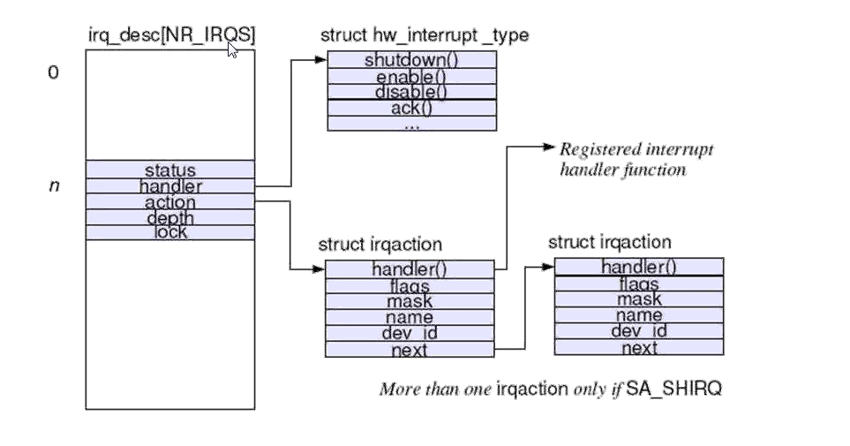
IRQ Descriptor illusion
Cat /proc/interrupts
Execute Code

Slide 8
Next, when it comes to the default behavior on the Linux OS, when a hardware interrupt
occurs and that interrupt isn't masked (always the default), let's say it's IRQn (where n is the IRQ number), the kernel ensures that while its interrupt (hardirq) handler executes, all interrupts on the local CPU core where the handler is executing are disabled and IRQn is disabled across all CPUs. Thus, your handler code is inherently reentrant-safe.
While IRQn executes on, say, CPU core 1, other interrupts remain enabled (unmasked) on all CPU cores but core 1. Thus, on multicore system hardware, interrupts can run in parallel on different CPU cores. This is fine as long as they don't step on each other's toes, with respect to global data! If they do, you'll have to employ locking
on Linux, all interrupts are peers, so there is no priority among them; in
other words, they all run at the same priority. Provided it's unmasked, any hardware
interrupt can interrupt the system at any point in time; an interrupt can even interrupt
interrupts! However, they typically don't do the latter. This is because, as we have just
learned, while an interrupt IRQn is running on a CPU core, all the interrupts on that core
are disabled (masked) and IRQn is disabled globally (across all cores) until it completes; the exception is an NMI.
The generic IRQ framework insists that you return the IRQ_HANDLED value if your driver handled theinterrupt. If the interrupt was not yours or you couldn't handle it, you should return the IRQ_NONE value
https://elixir.bootlin.com/linux/latest/source/drivers/net/ethernet/xilinx/xilinx_axienet_main.c#L1026

Slide 9
The handler runs in an interrupt context, so do not block: First and foremost,
this code always runs in an interrupt context; that is, an atomic context
Transfer data to and from kernel to user space as it might cause a page fault, which isn't allowed in an atomic context. Use the GFP_KERNEL flag in memory allocation. You must use the GFP_ATOMIC flag so that the allocation is non-blocking – it either
succeeds or fails immediately.
Invoke any API that's blocking (that, down the line, calls schedule() )
my_interrupt()
{
struct mys *sp;
ack_intr();
x = read_regX();
sp = kzalloc(SIZE_HWBUF, GFP_KERNEL);
if (!sp)
return -ENOMEM;
sp = fetch_data_from_hw();
copy_to_user(ubuf, sp, count);
kfree(sp);
}

Slide 10
// drivers/gpu/drm/exynos/exynos_mixer.c
[...]
res = platform_get_resource(mixer_ctx->pdev, IORESOURCE_IRQ, 0);
if (res == NULL) {
dev_err(dev, "get interrupt resource failed.\n");
return -ENXIO;
}
ret = devm_request_irq(dev, res->start, mixer_irq_handler,0, "drm_mixer",mixer_ctx);
if (ret) {
dev_err(dev, "request interrupt failed.\n");
return ret;
}
mixer_ctx-irq = res->start;
[...]
https://elixir.bootlin.com/linux/v6.3.2/source/drivers/input/misc/palmas-pwrbutton.c#L211
int __must_check
request_threaded_irq(unsigned int irq, irq_handler_t handler, irq_handler_t thread_fn,
unsigned long flags, const char *name, void *dev);
irq_handler_t thread_fn : The third parameter is a pointer to the threaded
interrupt function; the API behavior depends on whether you pass this parameter as null or not:
If it's non-null, then the actual servicing of the interrupt is performed by this function. It runs within the context (process) of a dedicated kernel thread – it's a threaded interrupt!
If it's null, which is the default when you call request_irq() , only the primary handler runs, and no kernel thread is created.

Slide 11
The primary handler if specified (second parameter), is run in what's referred to as
the hardirq or hard interrupt context (as was the case with request_irq() ). If the primary
handler is non-null, then you are expected to write it's code and (minimally) do the
following in it:
->Verify the interrupt is for you; if it's not, return IRQ_NONE .
-> If it is for you, then you can clear and/or disable the interrupt on the
board/device.
-> Return IRQ_WAKE_THREAD ; this will cause the kernel to wake up the kernel
thread representing your threaded interrupt handler. The name of the kernel
thread will be in the format irq/irq#-name . This kernel thread will now
internally invoke the thread_fn() function, where you perform the actual
interrupt handling work.
https://elixir.bootlin.com/linux/v6.3.2/source/drivers/net/wireless/realtek/rtw88/pci.c#L1161
Difference : `devm_*` additional support resource management for SoC based things.
static inline int __must_check
request_irq(unsigned int irq, irq_handler_t handler, unsigned long flags,
const char *name, void *dev)
{
return request_threaded_irq(irq, handler, NULL, flags, name, dev);
}
static inline int __must_check
devm_request_irq(struct device *dev, unsigned int irq, irq_handler_t handler,
unsigned long irqflags, const char *devname, void *dev_id)
{
return devm_request_threaded_irq(dev, irq, handler, NULL, irqflags,
devname, dev_id);
}

Slide 12
int devm_request_threaded_irq(struct device *dev, unsigned int irq,
irq_handler_t handler, irq_handler_t thread_fn,
unsigned long irqflags, const char *devname,
void *dev_id)
{
struct irq_devres *dr;
int rc;
dr = devres_alloc(devm_irq_release, sizeof(struct irq_devres), GFP_KERNEL);
}
The signature of the threaded interrupt handler function is identical to that for the hardirq interrupt handler:
static irqreturn_t threaded_handler(int irq, void *data);
The key advantage of this is that you don't need to worry about freeing up the IRQ line. The kernel will auto-free it on device detach or driver removal
IRQF_ONESHOT - Interrupt is not reenabled after the hardirq handler finished.
* Used by threaded interrupts which need to keep the
* irq line disabled until the threaded handler has been run.
Why use threaded interrupts
-> To really make it real time.useful for slow devices (need intr disable but process ctx)
-> It eliminates/reduces softirq bottlenecks. Since the threaded handler actually runs
its code in process context, it's not considered to be as critical a code path as a
hardirq handler; hence, you can take a little longer with interrupt handling.

Slide 13
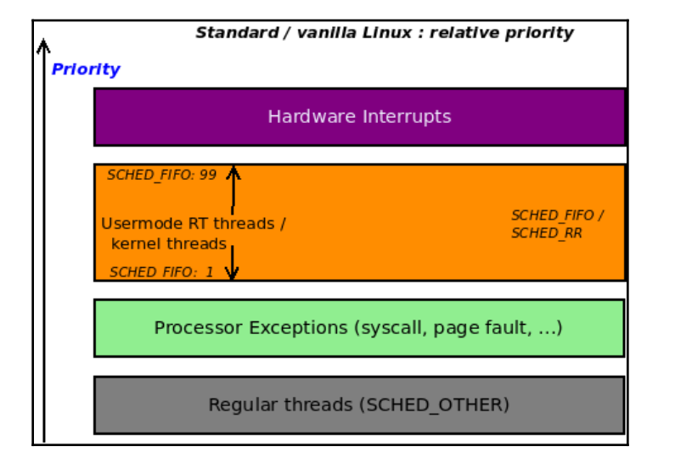
While a hardirq executes IRQn, that IRQ line is disabled on all the cores across the system. If it takes a while to execute to completion (of course, you should design it so that it doesn't), then the system's response can significantly drop; on the other hand, while a threaded handler executes, the hardware IRQ line is enabled by default. This is good for performance and responsiveness. (Note that there will be many cases where the driver will not want this behavior; that is, it will want IRQ to be disabled while it processes
it. To do that, specify the IRQF_ONSEHOT flag.)
If the interrupt handling consistently takes over 100 microseconds, use the threaded interrupt model

Slide 14
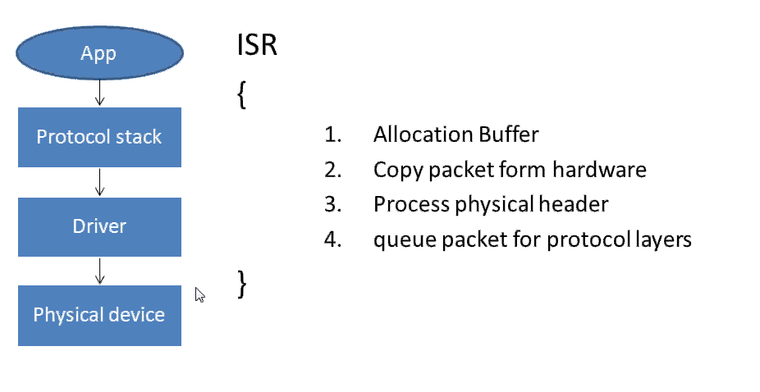
Interrupt handling is split into two halves – top and bottom
The so-called top half is the function that is initially invoked when the hardwareinterrupt is triggered. This is thus familiar to you - it's nothing but the hardirq, ISR, or primary handler routine that you registered via one of
the *request_*irq() APIs
(just for clarity: via one of these
APIs: request_irq() / devm_request_irq() / request_threaded_irq() /devm_request_threaded_irq() .)

Slide 15
The top half (hardirq) always runs with all interrupts disabled (masked) on the
current CPU and the IRQ it's handling disabled (masked) across all CPUs, but the
bottom half handler runs with all interrupts enabled.
Note that the bottom half is still very much running in an atomic or interrupt context! So,
the same caveats that apply to the hardirq (top half) handler also apply to the bottom-half handler:
You cannot transfer data (to or from user kernel spaces).
You can only allocate memory (if you really must) with the GFP_ATOMIC flag.
You cannot, ever, directly or indirectly, call schedule() .
This bottom-half handling is a subset of what's known as the kernel's deferred
functionality process; the kernel has several of these deferred functionality mechanisms:
Workqueues (based on kernel threads); context:process
Bottom half/tasklet (based on softirqs); context:interrupt
Softirqs; context:interrupt
kernel timers; context:interrupt
Threaded interrupt considered the modern approach to use; again, though its performance is acceptable for most peripherals, a few device classes – typically network/block/multimedia – might stillrequire the traditional top-bottom-half mechanisms to provide high enough performance.

Slide 16
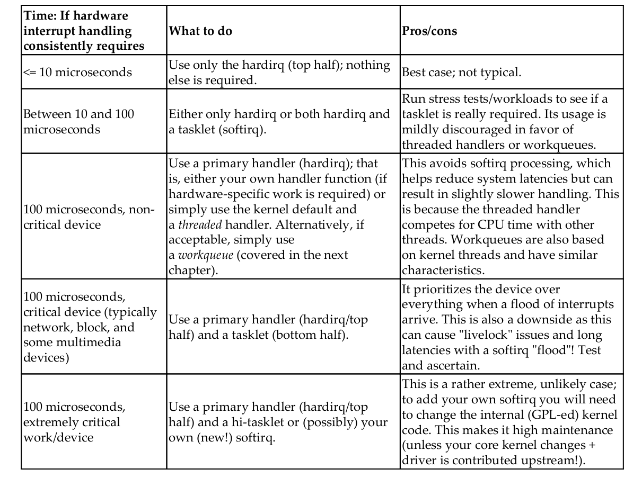

Slide 17
The kernel ensures that while its interrupt (hardirq) handler executes,
all interrupts on the local CPU core where the handler is executing are disabled and
IRQn is disabled across all CPUs. Thus, your handler code is inherently reentrant-safe.
This is good as it means you never have to worry about the following:
Masking interrupts yourself . When to run atomically, to completion and without interruption, on that CPU core
A bottom-half can still be interrupted by a top-half, thus necessitating locking.
While IRQn executes on, say, CPU core 1, other interrupts remain enabled (unmasked) on all CPU cores but core 1. Thus, on multicore system hardware, interrupts can run in parallel on different CPU cores. This is fine as long as they don't step on each other's toes, with respect to global data! If they do, you'll have to employ locking
On Linux, all interrupts are peers, so there is no priority among them; in
other words, they all run at the same priority. Provided it's unmasked, any hardware
interrupt can interrupt the system at any point in time
in_irq() macro will return true , informing you that your code is currently in a hardirq context.
From 2.6 we have three bottom half mechanisms in the kernel:
• Softirqs
• Tasklets
• Work Queues

Slide 18
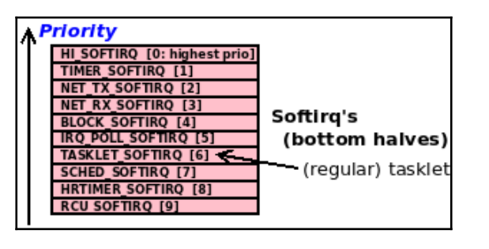
Softirqs
Softirqs are rarely used, tasklets are a much more common form of bottom half. But important point is that, tasklets are built on top of softirqs, so let us discuss softirqs first. The softirq code lives in kernel/softirq.c. Softirqs are statically allocated at compile-time. Unlike tasklets, we cannot dynamically register and destroy softirqs. Softirqs are represented by the softirq_action structure, which is defined in<linux/interrupt.h>. An array of 32 of these structures are defined in softirq.c file. So maximum possible softirqs are 32. However in the current kernel, only six of the 32 entries are used. Following are these softirqs.Softirqs run in interrupt – softirq – context; the in_softirq() macro returns true here, implying you are in a softirq (or tasklet) context.

Slide 19
Tasklets
Tasklets are bottom half mechanism built on top of softirqs. Tasklets are similar in nature and work in similar manner to softirqs; however, they have a simpler interface and relaxed locking rules. One of the key things that makes tasklets easier to use is the fact that (on an SMP system) a particular tasklet will never run in parallel with itself; in other words, a given tasklet will run on exactly one CPU at a time
DECLARE_TASKLET(name, func, data);
struct tasklet_struct my_tasklet = {NULL, 0, ATOMIC_INIT(0),
task_handler, dev);
struct tasklet_struct t;
tasklist_init(t, tasklet_handler, dev);
tasklet_schedule(struct tasklet_struct *);
→ The tasklet executes its code in an interrupt (atomic) context; it's actually a softirq context. So, remember, all the restrictions that apply to top halves apply here too!
→ Synchronization (on an SMP box):
→ A given tasklet will never run in parallel with itself.
→ Different tasklets can run in parallel on different CPU cores.
→ Your tasklet can itself be interrupted by a hardirq, including your
own IRQ! This is because tasklets, by default, run with all interrupts enabled on the local core, and, of course, hardirq's are the very top priority on the system
→ Locking implications really do matter

Slide 20
do_IRQ() -> handle_irq() -> entering_irq() -> hardirq top-half runs ->exiting_irq() -> irq_exit() -> invoke_softirq() -> do_softirq() -> ...bottom half runs: tasklet/softirq ... -> restore context
Work Queues
Work queues are a different form of deferring work from what we have looked so far. Work queues defer work into a kernel thread, the work always runs in process context. Thus, code deferred to a work queue has all the usual benefits of process context. Most importantly, work queues are schedulable and can therefore sleep
DECLARE_WORK (name, void (*func) (void *), void *data);
INIT_WORK(struct work_struct work, void (*func) (void *), void *data);
schedule_work(struct work_struct *);
in_irq() - We're in (hard) IRQ context
* in_softirq() - We have BH disabled, or are processing softirqs
* in_interrupt() - We're in NMI,IRQ,SoftIRQ context or have BH disabled
* in_serving_softirq() - We're in softirq context
* in_nmi() - We're in NMI context
* in_task() - We're in task context
The kernel allocates a separate kernel space stack per CPU for hardware interrupt handling. This is known as the IRQ stack. When a hardware interrupt arrives, the stack location (via the appropriate CPU stack pointer register) is switched to the IRQ stack of the CPU the interrupt is being processed on (and it's restored on IRQ exit). Some arch's (PPC) have a kernelconfig called CONFIG_IRQSTACKS to enable IRQ stacks. The size of the IRQ stack is fixed asthe value is arch-dependent. On the x86_64, it's 4 pages long (16 KB, with a typical 4K page size).

Slide 21
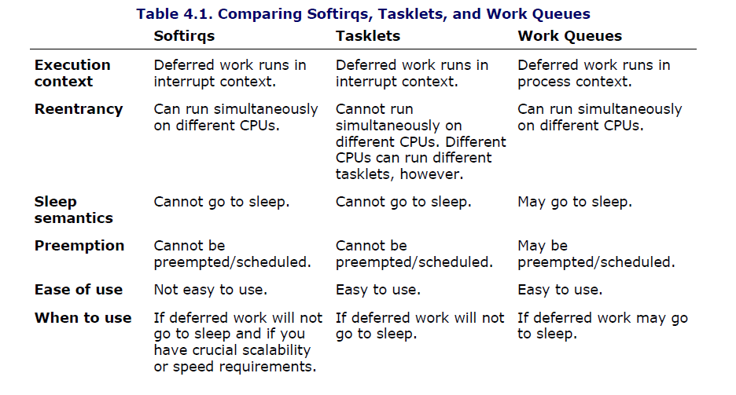

Slide 22
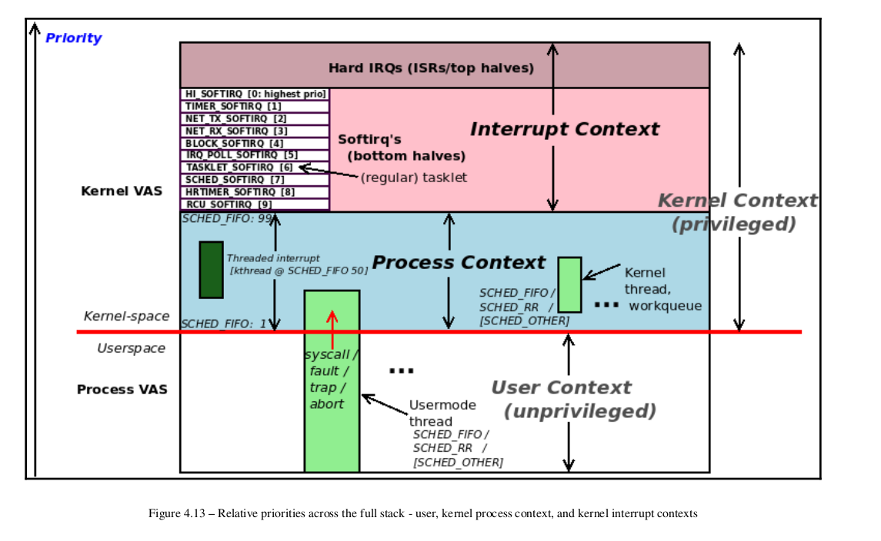
BPF Compiler Collection (BCC) is a toolkit for creating efficient kernel tracing and manipulation programs. It makes use of extended BPF (Berkeley Package Filter) and provides tools for BPF based Linux IO analysis, networking, monitoring and more
sudo apt-get install bpfcc-tools linux-headers-$(uname -r)
#softirqs-bpfcc 1
#hardirqs-bpfcc -d

